Slide 1
Arrays

Slide 2
Arrays
an array is a sequence of variable that can store value of one particular data type
Eg. int Num [1, 2, 5, 6]
char Name [ “Arjun” , “Appu” , “vishnu” ]

Slide 3
Arrays And Needs
The array stores a fixed-size sequential collection of elements of the same data type.
It can be access more than one data using a single variable.
A specific element in an array is accessed by an index
array_name [index]
All array have 0 is the index of 1st element. Called “base index”
If an array have “N” elements, then the last element index is “N – 1”

Slide 4
int mark [ 20 , 35 , 68 , 200 , 50 ]
Array Name
Index : 0 1 2 3 4
Base
index
N = 5 ,
then last index N -1 = 5 – 1
= 4

Slide 5
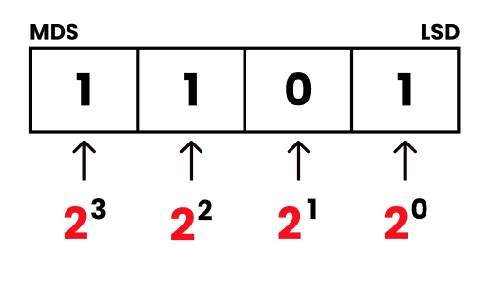
Defining Array
Array must declare before using it
Maximum number of elements an array can hold depends upon the
size of an array
Syntax :
DataType ArrayName [ ArraySize ];
int Number [ 4 ];
Number
0 1 2 3

Slide 6
Memory Allocation for Array
Memory allocation done with the help of data type
Character Type array have 1 bytes of memory
Integer Type array have 2 bytes of memory
Floating Point Type array have bytes of memory
Example :
int Number [ 4 ];
2 byte x 4 = 8 byte

Slide 7
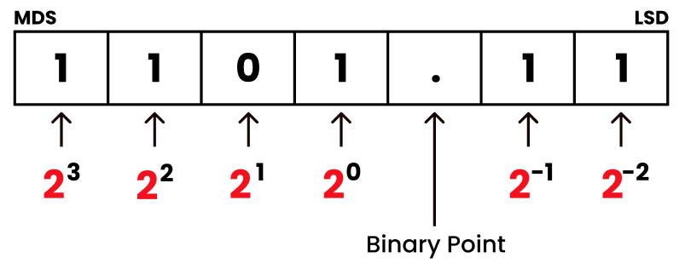
Array Initialization
It is the process of storing initial values into the array memory
Syntax :
int item[ 3 ] = { 10 , 5 , 25 } ;
int item[ 5 ] = { 10 , 5 , 25 } ;
10 5 25
10 5 25

Slide 8
Accessing the elements of an array
It is the way of storing elements in to an array
An element is accessed by indexing the array name; it is done by placing the index of the element with in square brackets [ ].
Int item[3] = 10 ;

Slide 9
Accessing methods
int a[10] = {10, 11, 34, 55, 26 } ;
int a[ ] = { 34, 55, 26 } ;
int a[0] = 10, a[1] = 11 , a[2] = 34 ;
int a[10];
for ( int i = 0; i < 10 ; i ++)
{
cin>> a[ i ] ;
}

Slide 10
Arrays Types

Slide 11
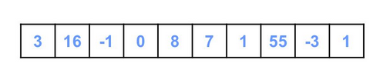
Int array
0 1 2 3 4 5 6 7 8 9
Int Num[ ] = { 3, 16, -1, 0, 8, 7, 1, 55, -3, 1 };

Slide 12
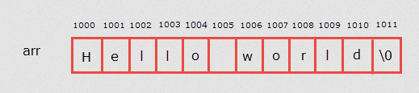
Char array
0 1 2 3 4 5 6 7 8 9 10 11
char text[ ] = { 'H', 'e', 'l', 'l', 'o', '\0' };
char text[ ] = “ Hello ” ;

Slide 13
Arrays Operations

Slide 14
Simple Arrays Operations
The operations performed on array
Traversal
Sorting
Selection Sorting
Bubble Sorting
Searching
Linear Search
Binary Search
Insertion
Deletion
Merging

Slide 15
Traversal
Traversal means accessing each elements at least once.
Use this operation to check the correctness of insertion, deletion ,etc..
Displaying all the elements of an array is an example.

Slide 17
Sorting
Process of arranging the elements of the array in some logical order
2 algorithm used
Selection Sorting
Bubble Sorting

Slide 18
1) Selection Sorting
Simple sorting techniques
To sort an array in ascending order,
the selection sort algorithm starts by finding the minimum value in the array and move it to the 1st position.
At the same time, the element at the 1st position is shifted to the position of smallest element.
This step repeats.
10
3
5
4
2
8
15
2
3
5
4
10
8
15

Slide 19
working
Logic : Array is considered in to 2 parts
Unsorted part
Sorted Part
Selection : 1. Select the lowest element in the remaining array
Swapping : 2. Bring it to the starting position
Counter Shift : 3. change the counter for unsorted array by 1
10
3
5
4
2
8
15
2
3
5
4
10
8
15

Slide 20
Sorted
Unsorted
10
3
2
5
2
3
10
5
2
3
10
5
2
3
5
10
Starting Position

Slide 21
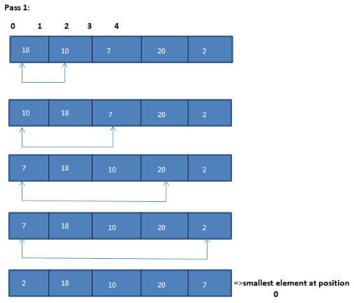

Slide 22
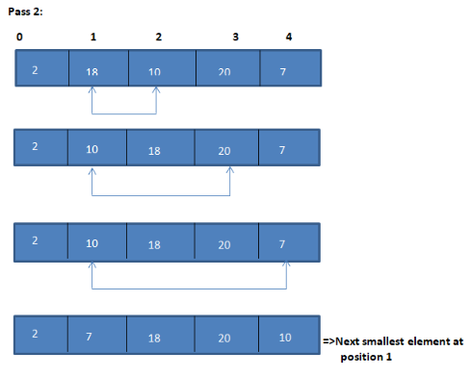

Slide 23
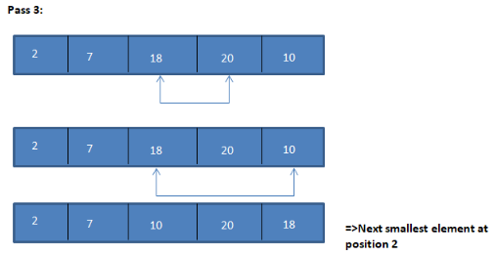

Slide 24
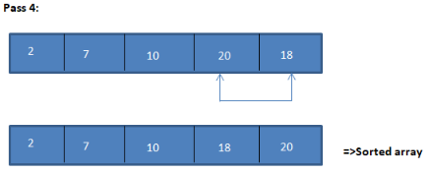

Slide 25
2) Bubble Sorting
Simple sorting techniques
It working by repeatedly swapping the adjacent elements if they are in wrong order.
It shift largest element at the last position
10
3
5
4
2
8
15
3
10
5
4
2
8
15

Slide 26
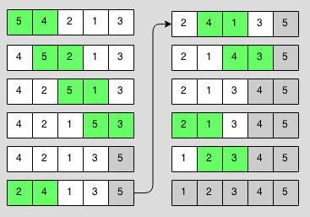
Sorted part
Largest element

Slide 28
Searching
Process of finding the location of the given elements in an array.
2 algorithm used
Linear Search
Binary Search

Slide 29
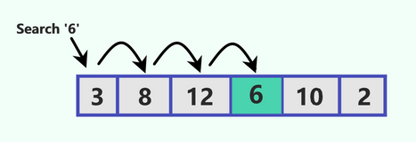
1) Linear Search
Also called Sequential search.
It is a method for finding a particular value in a list
Linear search consist of checking each element in the list, once at a time
Start from 1st element ;
Ends when the value was founded
3
10
5
4
2
8
15

Slide 30
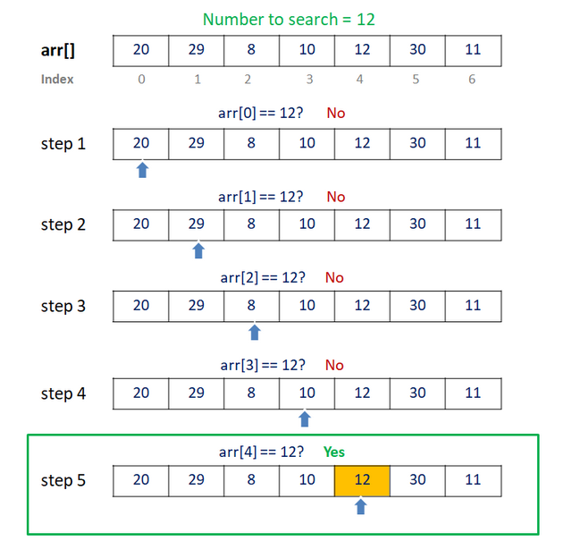

Slide 31
2) Binary Search
Used in large arrays
More efficient search
Fast searching than others
It works only in sorted arrays

Slide 32
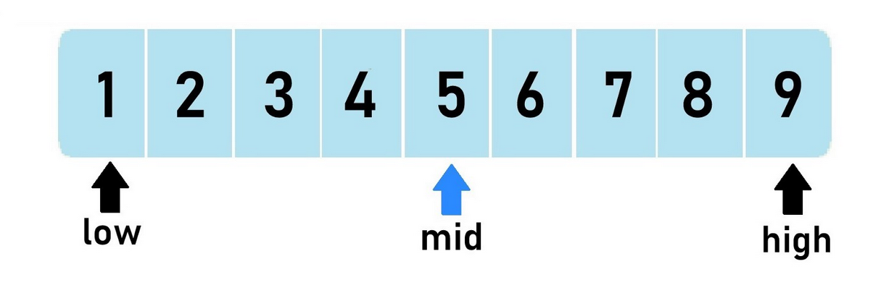
Search a sorted array by repeatedly dividing the search interval in half
Begin with an interval covering the whole array
If the search value is less than the middle item, narrow the interval to the lower half. Otherwise narrow it to the upper half.
To calculate middle index
mid = (low + high) / 2; (Integer part only taken )
(0 + 9) / 2 = 4.5 = 4

Slide 33
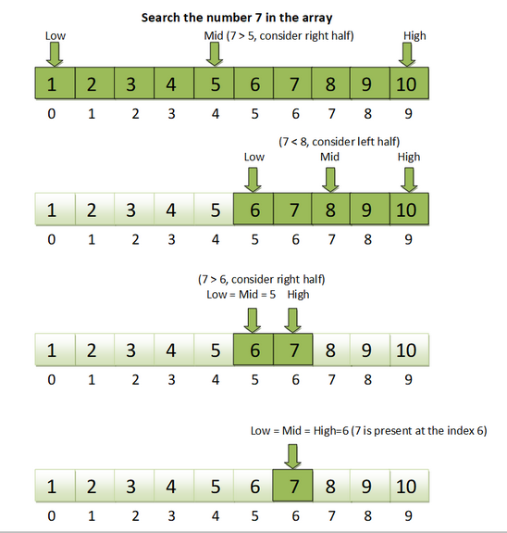
Mid = (0 + 9) / 2
Mid = 4.5
Mid = 4
Mid = (5 + 9) / 2
Mid = 7
Mid = (5 + 6) / 2
Mid = 5.5
Mid = 5
Low = High

Slide 35
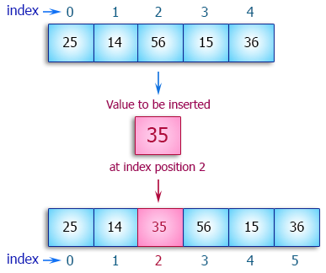
Insertion
It is the operation to insert one or more data elements into an array
Based on the requirements, new data can be added at beginning, end or any given index

Slide 37
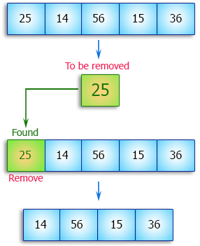
Deletion
It is the operation to remove one or more data elements from an array
Based on the requirements, data can be removed at beginning, end or any given index

Slide 39
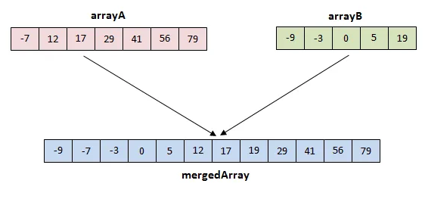
Merging
It is the operation to adding or concatenate one array element with another array element.

